Slide 1
Factorial Design
A factorial design of experiments is a statistical method used to study the effects of multiple factors on a response simultaneously. It can be used to:
Identify significant factors
Factorial designs can help identify significant factors and interactions between them.
Reduce the need for separate experiments
Factorial designs allow you to examine multiple factors within the same study, reducing the need for separate experiments for each variable.
Obtain maximum information from a limited number of experiments
Factorial designs can be an efficient way to obtain maximum information from a limited number of experiments.

Slide 2
Factorial Design
There are two types of factorial designs: full factorial and fractional factorial:
Full factorial
In a full factorial design, all combinations of factors are investigated in each replicate of the experiment. This is the only way to completely and systematically study interactions between factors.
Fractional factorial
A fractional factorial design is a carefully chosen subset of the experimental runs of a full factorial design. This is useful when you can't afford a full replicate of the full factorial design.
Factorial experiment
A factorial design allows the effect of several factors and even interactions between them to be determined with the same number o...

Slide 3
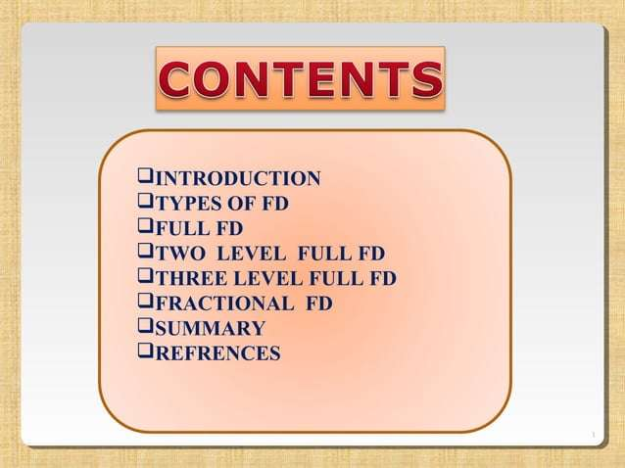

Slide 4
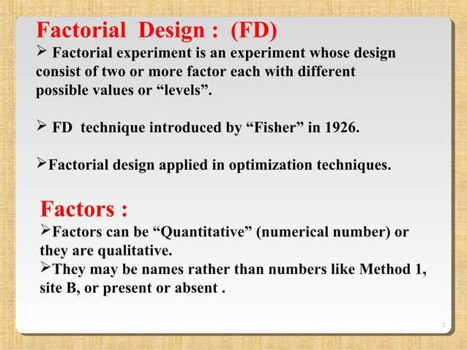

Slide 5
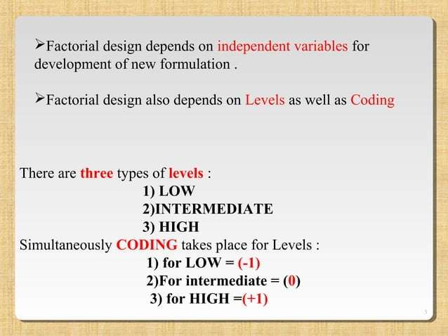

Slide 6
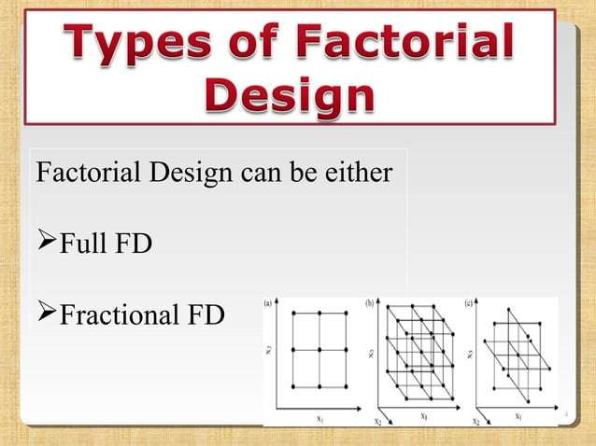

Slide 7
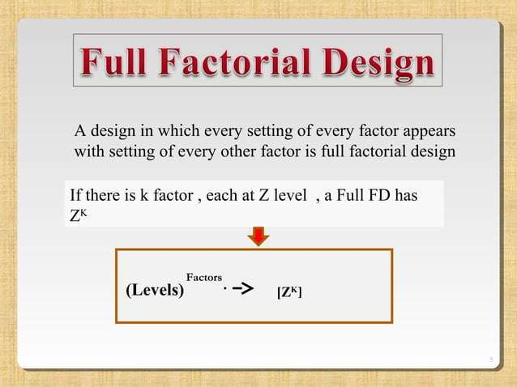

Slide 8
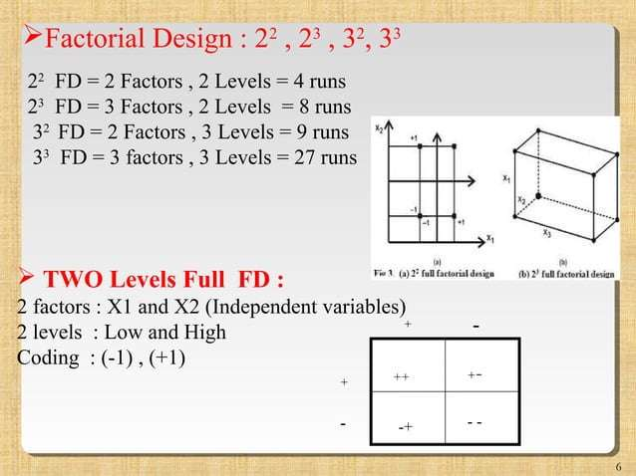

Slide 9
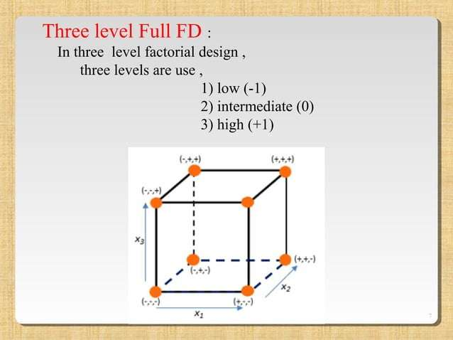

Slide 10
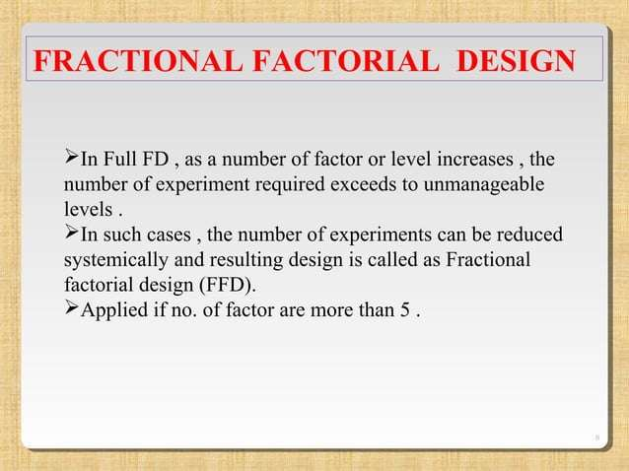

Slide 11
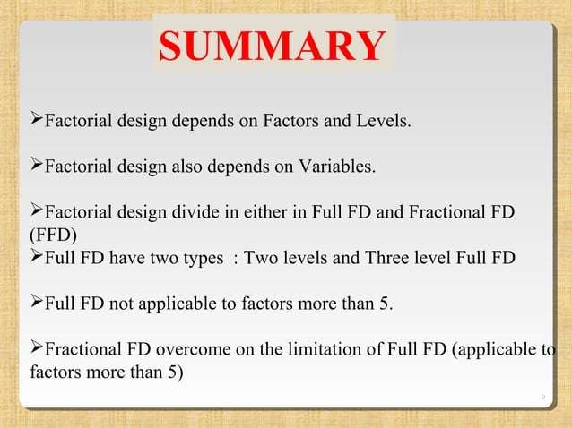

Slide 12


